Slide 1
MGMT 58600: Python Programming
Lecture 4
Dr. Shoaib Khan

Slide 2
Scope of Variables
Parameters and variables that are assigned inside a function are said to exist in that function’s local scope.
Variables that are assigned outside all functions are said to exist in the global scope.
A variable that exists in a local scope is called a local variable
A variable that exists in the global scope is called a global variable.

Slide 3
Scoping Rules
Local variables cannot be used in the global scope
def spam(): eggs = 31337 spam() print(eggs)
Local scopes cannot use variables in other local scopes
def spam(): eggs = 99 bacon() print(eggs) def bacon(): ham = 101 eggs = 0 spam()

Slide 4
Scoping Rules
Global variables can be read from a local scope
def spam(): print(eggs)
eggs = 42 spam() print(eggs)
Local and global variables with the same name
def spam(): eggs = 'spam local' print(eggs) # prints 'spam local' def bacon(): eggs = 'bacon local' print(eggs) # prints 'bacon local' spam() print(eggs) # prints 'bacon local’ eggs = 'global' bacon() print(eggs) # prints 'global'

Slide 5
The global Statement
If you need to modify a global variable from within a function, use the global statement
def spam(): global eggs eggs = 'spam' eggs = 'global' spam() print(eggs)

Slide 6
Four Rules
There are four rules to tell whether a variable is in a local scope or global scope:
If a variable is being used in the global scope (that is, outside of all functions), then it is always a global variable.
If there is a global statement for that variable in a function, it is a global variable.
Otherwise, if the variable is used in an assignment statement in the function, it is a local variable.
But if the variable is not used in an assignment statement, it is a global variable.

Slide 7
Exception Handling
Until now, getting an error, or exception, in our Python program meant the entire program will crash.
We don’t want this to happen in real-world programs.
Instead, we want the program to detect errors, handle them, and then continue to run.
These exceptions can be handled using the try and except statements
For example, consider the following program, which has a divide-by-zero error

Slide 8
Exception Handling
def spam(divideBy): return 42 / divideBy print(spam(2)) print(spam(12)) print(spam(0))
You can put this divide-by-zero code in a try clause and have an except clause contain code to handle what happens when this error occurs.
def spam(divideBy): try: return 42 / divideBy except ZeroDivisionError: print('Error: Invalid argument.') print(spam(2)) print(spam(12)) print(spam(0)) print(spam(1))

Slide 9
Review: Python Data Structures
A data structure is a collection of different data types that has a set of specific operations that can be performed on it
Built-in data structures in Python can be divided into two broad categories: mutable and immutable
Mutable data structures are those which we can modify e.g., by adding, removing, or changing their elements.
Python has three mutable data structures: lists, dictionaries, and sets
Immutable data structures are those that we cannot modify after their creation
The only basic built-in immutable data structure in Python is a tuple.

Slide 10
Review: Lists
List is a sequence data type which is used to store a collection of data
Suppose we need to record the ages of 5 students. Instead of creating 5 separate variables, we can simply create a list
ages = [17, 18, 19, 26, 23]
print(ages)
A list can store elements of different types (integer, float, string, etc.) and store duplicate elements
# list with elements of different data types
list1 = [1, "Hello", 3.4]
# list with duplicate elements
list1 = [1, "Hello", 3.4, "Hello", 1]
# empty list
list3 = []

Slide 11
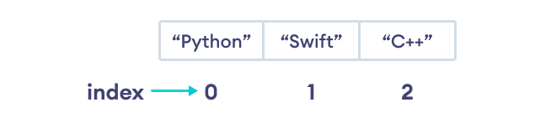
Indexing
Lists are ordered and each item in a list is associated with a number. The number is known as a list index.
The index of the first element is 0, second element is 1 and so on e.g.,
languages = ["Python", “Swift", "C++"]
# access item at index 0
print(languages[0]) # Python
# access item at index 2
print(languages[2]) # C++

Slide 12
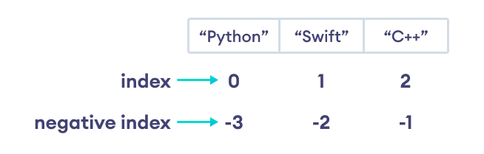
Negative Indexing
Python allows negative indexing for its sequences. The index of -1 refers to the last item, -2 to the second last item and so on.
languages = ["Python", "Swift", "C++"]
# access item at index 0
print(languages[-1]) # C++
# access item at index 2
print(languages[-3]) # Python

Slide 13
Slicing
In Python, it is possible to access a portion of a list using the slicing operator “:” e.g.,
# List slicing in Python
my_list = ['p','r','o','g','r','a','m','i','n']
# items from index 2 to index 4
print(my_list[2:5])
# items from index 5 to end
print(my_list[5:])
# items beginning to end
print(my_list[:])

Slide 14
Add Elements to a List
Using append(): the method adds an item at the end of the list. E.g.,
numbers = [21, 34, 54, 12]
print("Before Append:", numbers)
# using append method
numbers.append(32)
print("After Append:", numbers)
Using extend(): the method adds all the items of an iterable (list, tuple, string, dictionary, etc.) to the end of the list. E.g.,
numbers = [1, 3, 5]
even_numbers = [4, 6, 8]
# add elements of even_numbers to the numbers list
numbers.extend(even_numbers)
print("List after append:", numbers)

Slide 15
Add Elements to a List
Using insert(): this method adds an element at a specified index. E.g.,
numbers = [10, 30, 40]
# insert an element at index 1 (second position)
numbers.insert(1, 20)
print(numbers) # [10, 20, 30, 40]

Slide 16
Changing List Items
Python lists are mutable (can be modified). We can change items of a list by assigning new values using the = operator. E.g.,
languages = ['Python', 'Swift', 'C++']
# changing the third item to 'C'
languages[2] = 'C'
print(languages) # ['Python', 'Swift', 'C']

Slide 17
Remove Items From a List
Using del statement: removes one or more items from a list. E.g.,
languages = ['Python', 'Swift', 'C++', 'C', 'Java', 'Rust', 'R']
# deleting the second item
del languages[1]
print(languages) # ['Python', 'C++', 'C', 'Java', 'Rust', 'R']
# deleting the last item
del languages[-1]
print(languages) # ['Python', 'C++', 'C', 'Java', 'Rust']
# delete the first two items
del languages[0 : 2] # ['C', 'Java', 'Rust']
print(languages)

Slide 18
Remove Items From a List
We can also use the remove() method to delete a list item. For example,
languages = ['Python', 'Swift', 'C++', 'C', 'Java', 'Rust', 'R']
# remove 'Python' from the list
languages.remove('Python')
print(languages) # ['Swift', 'C++', 'C', 'Java', 'Rust', 'R']

Slide 19
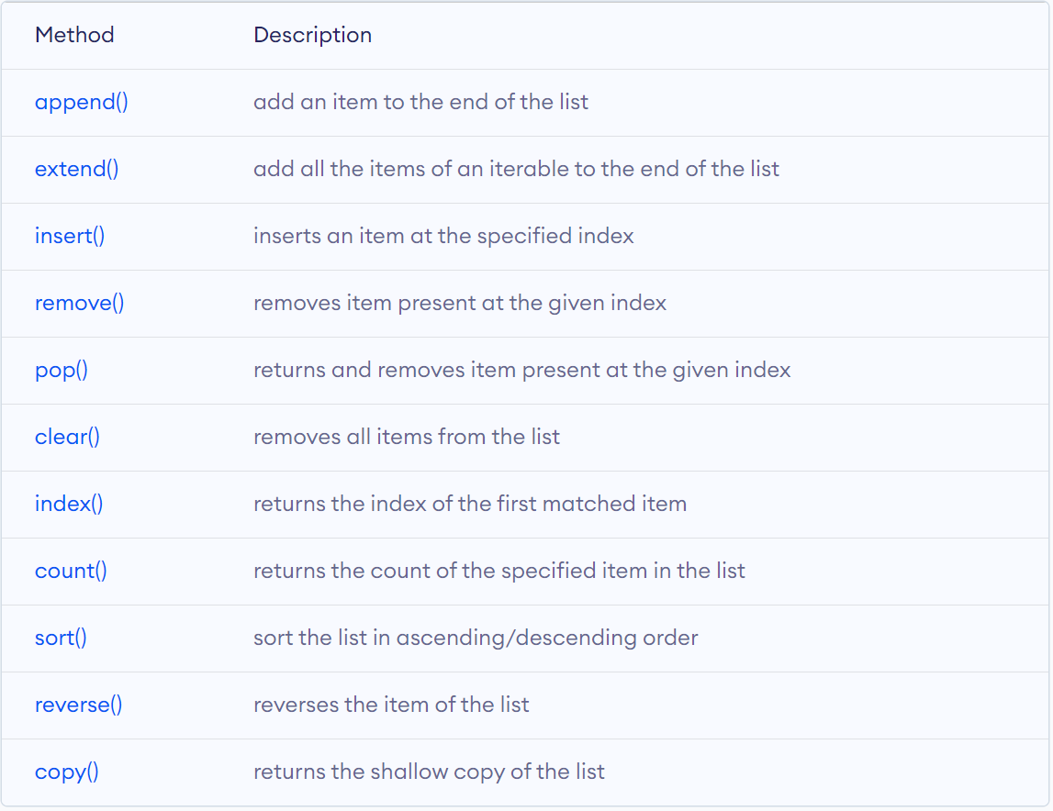
List Methods
Python has many useful list methods that makes it really easy to work with lists.

Slide 20
Sorting a List
sort() method is used to sort the elements of a list in ascending order by default. E.g.,
unsorted_list = [2,4,5,32,6,255,5,42]
unsorted_list.sort()
print("Now it is sorted:", unsorted_list)
To sort a list in descending order, set the reverse parameter to True of the sort() method. E.g.,
# List of Integers
numbers = [1, 3, 4, 2]
# Sorting list of Integers
numbers.sort(reverse=True)
print(numbers) # List of Floating point numbers
decimalnumber = [2.01, 2.00, 3.67, 3.28, 1.68]
# Sorting list of Floating point numbers
decimalnumber.sort(reverse=True)
print(decimalnumber)
# List of strings
words = [“programming", “is", “fun"]
# Sorting list of strings
words.sort(reverse=True)
print(words)

Slide 21
Working With Lists
Iteration: We can use a for loop to iterate over the elements of a list. For example,
languages = ['Python', 'Swift', 'C++']
# iterating through the list
for language in languages:
print(language)
Check if an Element Exists in a List: We use the ‘in’ keyword to check if an item exists in the list or not. For example,
languages = ['Python', 'Swift', 'C++']
print('C' in languages) # False
print('Python' in languages) # True

Slide 22
List Comprehension
List comprehension is a concise and elegant way to create lists. For example,
# create a list with value n ** 2 where n is a number from 1 to 5
numbers = [n**2 for n in range(1, 6)]
print(numbers)

